Slide 1

Interactive Sales Dashboard
An Overview of Key Business Insights

Slide 2
Sales Performance Overview
Analyzing sales data for informed business decisions
Visualize company performance
Informed business decisions
Focus on Sales and Profit
Product Performance insights
Geographical Insights
Time-based Trends

Slide 3
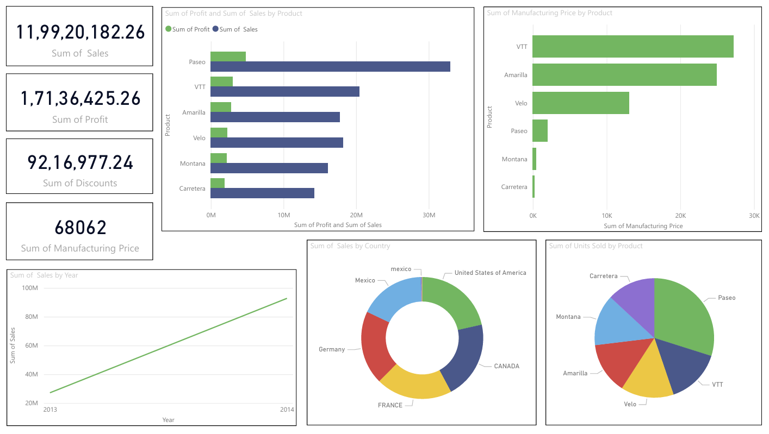

Slide 4
Dashboard Summary:Sales Performance Analysis
Overview,
This interactive dashboard provides a comprehensive analysis of the company’s sales, profit, product performance, and market reach, helping stakeholders make data-driven decisions
Key Metrics (KPIs) :
Total Sales: ₹11,99,20,182.26
Total Profit: ₹1,71,36,425.26
Total Discounts Given: ₹92,16,977.24
Total Manufacturing Price: ₹68,062
Insights from Visualizations :
Product Performance
Top Seller: Paseo, followed by VTT and Amarilla.
Paseo leads in sales; VTT has the highest manufacturing cost.
Units sold are fairly distributed, with Paseo leading.
Geographical Analysis
Top Markets: United States, Canada, and France.
Country-wise donut chart shows regional distribution of sales.
Time-Series Trend
Clear upward sales trend from 2013 to 2014, indicating business growth.
Stakeholder Insights
Identify best-selling products and optimize underperformers.
Analyze regional markets for targeted strategy.
Assess profitability vs manufacturing cost for product-level planning.
Understand yearly growth for forecasting and resource planning.
Dashboard Features :
Cards for totals (Sales, Profit, Discounts, Manufacturing Price)
Bar Charts to compare Sales & Profit by Product
Pie/Donut Charts for Country-wise Sales & Units Sold
Line Chart for Yearly Sales Trend
Consistent Color Theme for clarity
Optional Slicers (filters) can be added for interactivity

Slide 5
Thank You !!!

